Slide 1
VWR Safety and MRO Portfolio

Slide 2
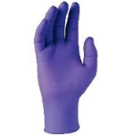


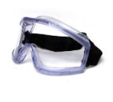
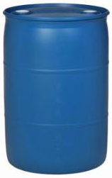
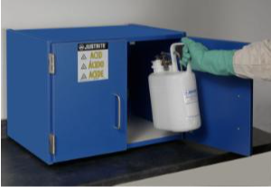
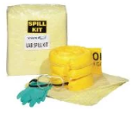

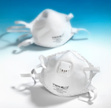

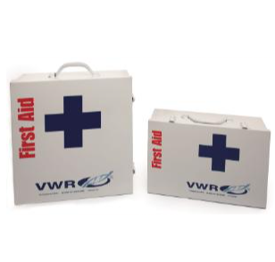
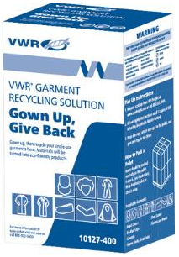
Avantor Safety and Industrial Portfolio
Product Solutions and Services
Exam & Industrial Gloves
Head to Toe Industrial Apparel
Cut Resistant
Eye & Face Protection
Facility Protection
Packaging and Storage
Spill Control & Absorbents
Signage & Printers/Labels
Hearing & Respiratory Protection
Flooring & Matting
First Aid & Refills
Sustainable Solutions

Slide 3
Safety and Industrial Focus: Product Offering Awareness
Protect Yourself and Employees:
Apparel – (protective, industrial, fire-resistant, and chemical)
Eye & Face Protection (glasses, goggles, face shields, and masks)
Fall Protection
First Aid
Foot Protection
Gas Detection and Monitoring
Gloves, Disposable (nitrile, latex, vinyl)
Gloves, Industrial (cut-resistant, chemical resistant)
Head Protection
Hearing Protection
Radiation Protection
Respiratory Protection (disposable, reusable, and PAPR)
Protect Your Facility and Product:
Ergonomics and Matting
Lockout/Tagout
Material Handling and Storage
Safety Cabinets and Cans
Safety Signs
Spill Control Products and Kits
Waste Disposal
Other Services:
Prescription Eyewear Programs
Recycling & Waste Programs
Industrial Supplies / MRO
Office Supplies
Supplier Services – Safety Consultations/Audits

Slide 4
New and Unique Solutions:
Recycling Services and Waste Disposal
  General/Mixed Personal Protective Equipment (PPE)
  Synthetic Wipers – Saturated and Dry
  Garments, Gloves, or Glasses dedicated programs
  Battery and Lightbulb
  Aerosol
  Waste-to-Energy
Sustainable Solutions
  Industrial and Safety Supplies produced from Recycled Content
Full line of proprietary branded glove and gowning

Slide 5
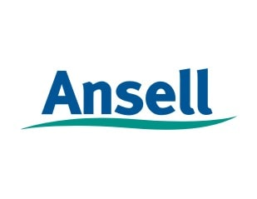


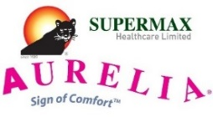



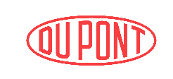



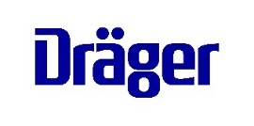

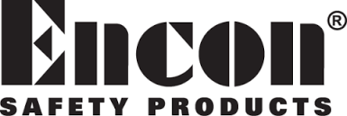
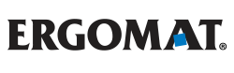






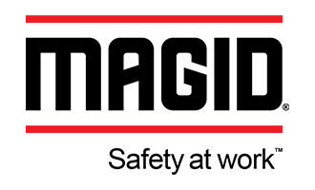






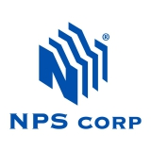


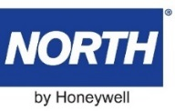


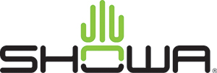

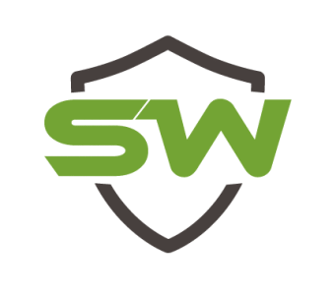
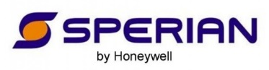


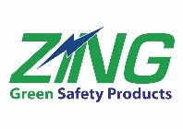




Some of Our Key Safety Suppliers:
In addition, we partner many leading MRO and Industrial suppliers to bring you over 500+ brands

Slide 6

Safety Assessments and Ongoing Consulting:
Train-the-Trainer Program
Guardian Program
Safety Shower Inspections
Flooring Site Assessment
Service Provided:
Train and certify a designated employee at customer’s company to perform onsite respirator fit testing for your workers.
Cost to VWR Customers:
Free
Benefits:
◊ Improve Safety Performance
◊ Manage Risk and Compliance
◊ Reduce need to bring in third party fit testing for each new hire
Service Provided:
Site assessment with personalized risk management solutions using an integrated approach of Safety, Productivity and Costs.
Cost to VWR Customers:
Free
Benefits:
◊ Improve Worker Safety
◊ Increase Compliance
◊ Optimize PPE Dispensing
◊ Reduce Injuries and Down Time
◊ SKU Reduction/Standardization
Service Provided:
On-Site Safety Shower inspections with report on each shower by location advising of repairs, parts and signs needed for compliance and replacements.
Cost to VWR Customers:
Free, once for customers not using Encon. Free annually for customers already using Encon.
Benefits:
◊ Ensure Showers are working
properly
◊ Minimize OSHA fines
◊ Encon will train a customers’ employee on procedures
Service Provided:
Site assessment with a detailed report with recommendations for ergonomic flooring and matting to address the needs of the facility.
Cost to VWR Customers:
Free, $2k value
Benefits:
◊ Improve Safety Performance
◊ Prevent Lost Time
◊ Manage Risk and Compliance
◊ Reduce Down-Time
◊ Heighten Morale & Productivity

Slide 7
Safety Assessments and Ongoing Consulting:
Clean Plant Assessment
STUD-E Survey
Facility Marking Audit
Fall Protection Assessment
Service Provided:
Assessment includes observation of current liquid storage and disposal procedures, with recommendations for safety improvements, along with training for proper application of products.
Cost to VWR Customers:
Free
Benefits:
◊ Maximize Performance
◊ Reduce Waste
◊ Increase compliance with Occupational Regulations
Service Provided:
Address hazardous material handling program (Storage, Transfer, Use and Disposal of hazardous liquids in an Evaluation format).
Cost to VWR Customers:
Free
Benefits:
◊ Improve Worker Safety
◊ Increase handling efficiencies
◊ Protect the environment to
meet sustainability initiatives
◊ Assure compliance to OSHA and EPA regulations
Service Provided:
Evaluation of general safety signage, PPE notices, confined space warnings, safety shower and eyewash identification, fire protection equipment, pipe marking, electrical panel safety marking, etc.
Cost to VWR Customers:
Free
Benefits:
◊ Improve Workplace Safety
◊ Minimize OSHA fines
Service Provided:
A Miller Fall Protection Specialist can come to your site and discuss all of your fall protection needs.
Cost to VWR Customers:
Free
Benefits:
◊ Improve Worker Safety
◊ Manage Risk and Compliance
◊ Prevent Lost Time
◊ Reduce Down-Time
◊ Minimize OSHA fines

Slide 8




Safety Assessments and Ongoing Consulting:
Plant Assessment
Smart Safety Assessment
360 Protection Program
Certified Industrial Hygienist
Service Provided:
Help create and implement a safety program at the customers facility. Risk assessments include Arc Flash and Visual Workplace reviews. Additional support in Lockout/Tagout, Confined Space, and Hazardous Communication.
Cost to VWR Customers:
Free
Benefits:
◊ Engage workforce for safety focus
◊ Increase and maintain compliance with Occupational Regulations
Service Provided:
Assessment to review a plants use of PPE products through prior injury reports, job descriptions, list of current PPE policies, plant observations, and employee engagement. This includes a follow up of all products and a cost savings plan
Cost to VWR Customers:
Free
Benefits:
◊ Improve Worker Safety
◊ Provide cost effective solutions
◊ Increase employee participation in Safety
Service Provided:
The program is designed to perform a complete assessment of the current safety gear used and its performance. Emphasis on cost savings, productivity, and risk reduction.
Cost to VWR Customers:
Free
Benefits:
◊ Provide immediate and eventual cost savings
◊ Reduce risk of injury to employees
◊ Assess areas for increased productivity
Service Provided:
Certified Industrial Hygienist (CIH) will provide evaluation and products for consideration in order to best protect from chemicals and other hazards used.
Cost to VWR Customers:
Free
Benefits:
◊ Reduce risk of injury to employees
◊ Assess areas for increased productivity
◊ Increase and maintain compliance with regulations

